Slide 1
Chapter 13: Data Storage Structures
Source- https://www.db-book.com

Slide 2
File Organization
The database is stored as a collection of files. Each file is a sequence of records. A record is a sequence of fields.
One approach
  Assume record size is fixed
  Each file has records of one particular type only
  Different files are used for different relations
  This case is easiest to implement; will consider variable length records later
We assume that records are smaller than a disk block
  .

Slide 3
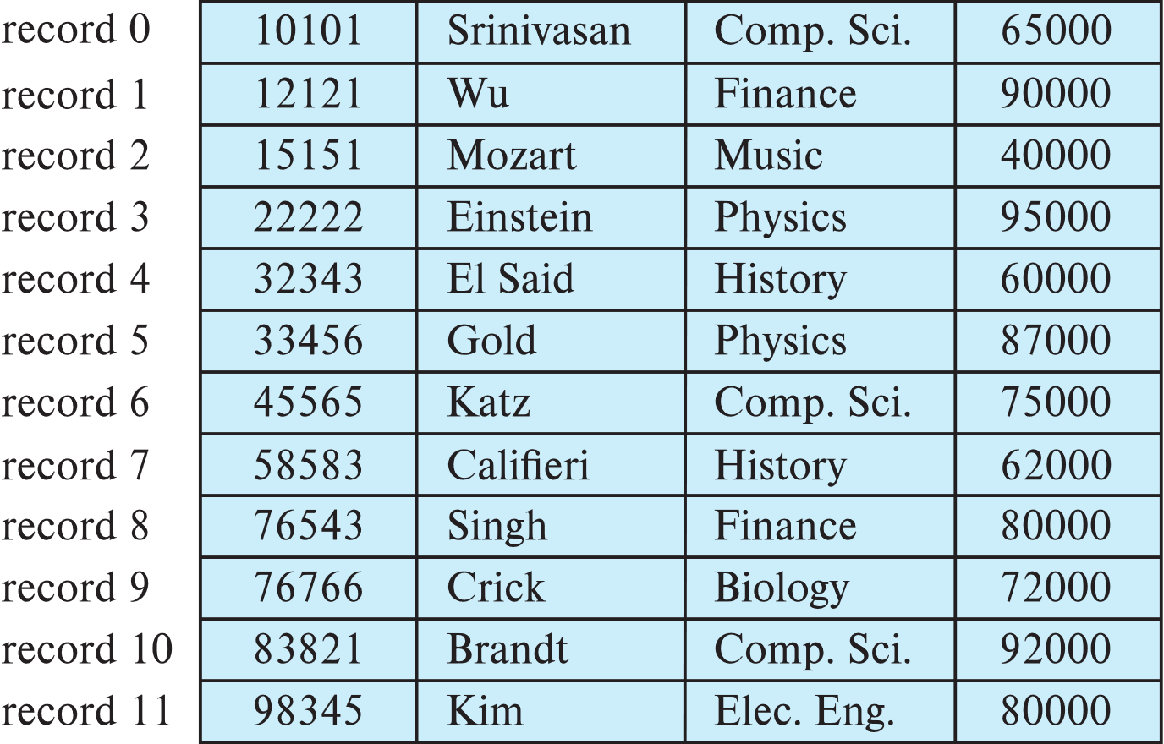
Fixed-Length Records
Simple approach:
  Store record i starting from byte n ∗ (i – 1), where n is the size of each record.
  Record access is simple but records may cross blocks
    Modification: do not allow records to cross block boundaries

Slide 4
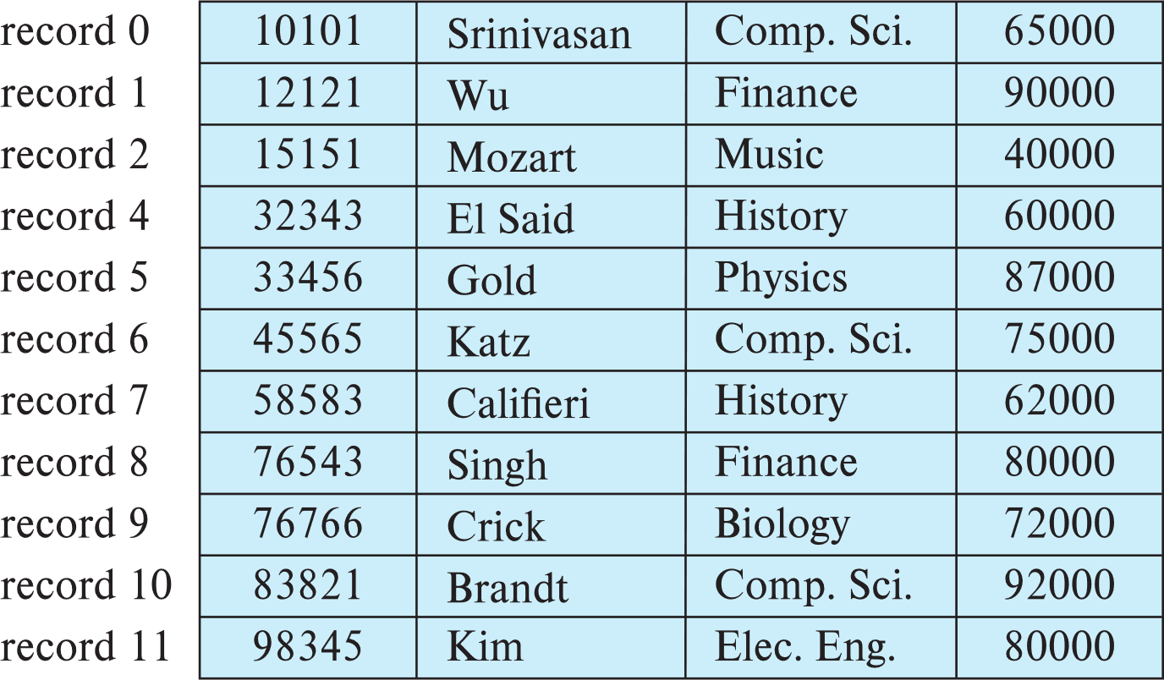
Fixed-Length Records
Deletion of record i: alternatives:
  move records i + 1, . . ., n to i, . . . , n – 1
  move record n to i
  do not move records, but link all free records on a free list
  Record 3 deleted

Slide 5
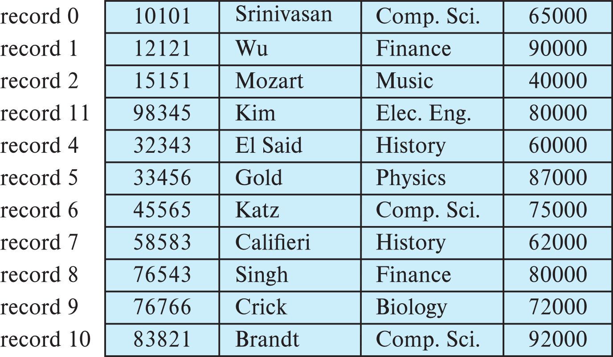
Fixed-Length Records
Deletion of record i: alternatives:
  move records i + 1, . . ., n to i, . . . , n – 1
  move record n to i
  do not move records, but link all free records on a free list
  Record 3 deleted and replaced by record 11

Slide 6
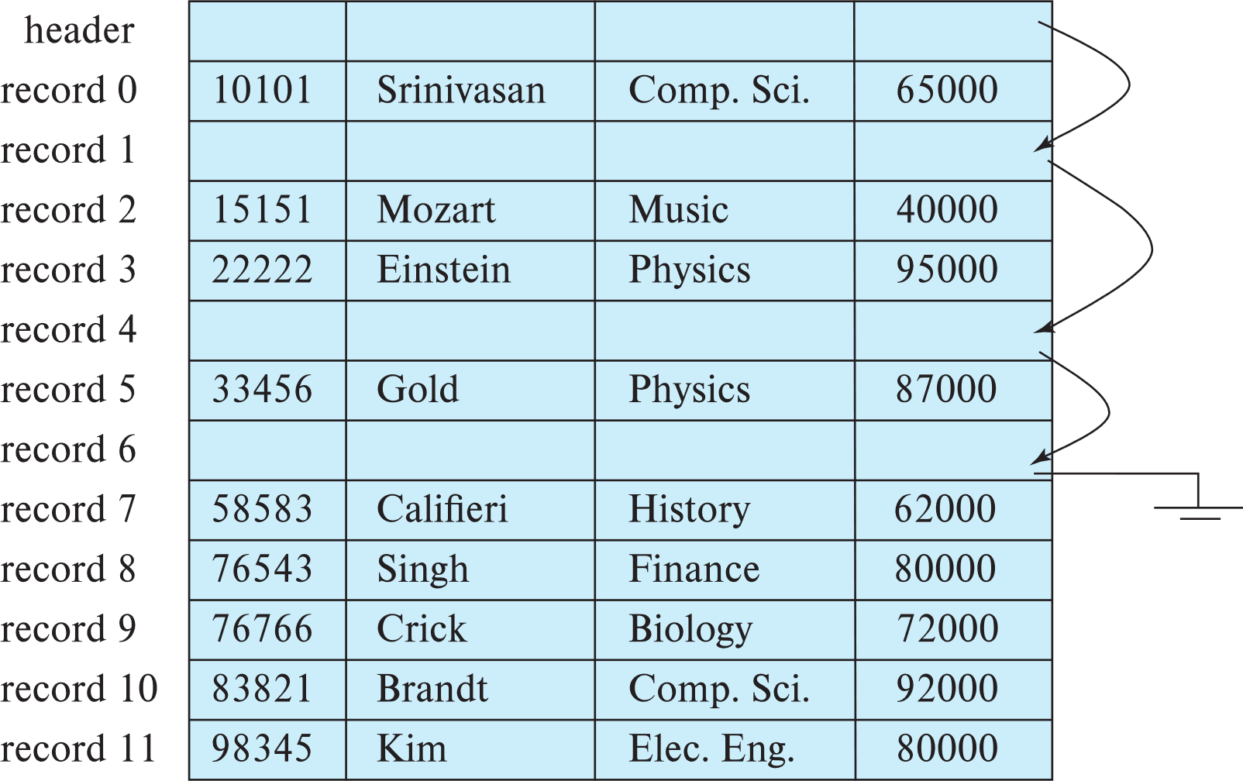
Fixed-Length Records
Deletion of record i: alternatives:
  move records i + 1, . . ., n to i, . . . , n – 1
  move record n to i
  do not move records, but link all free records on a free list

Slide 7
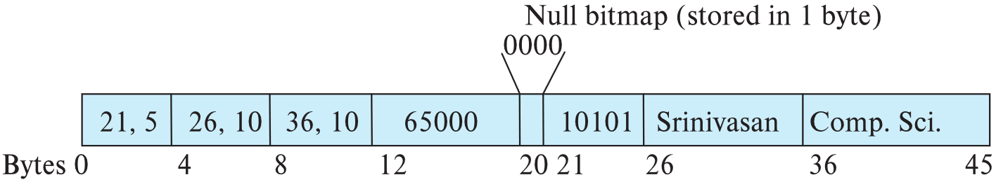
Variable-Length Records
Variable-length records arise in database systems in several ways:
  Storage of multiple record types in a file.
  Record types that allow variable lengths for one or more fields such as strings (varchar)
  Record types that allow repeating fields (used in some older data models).
Attributes are stored in order
Variable length attributes represented by fixed size (offset, length), with actual data stored after all fixed length attributes
Null values represented by null-value bitmap

Slide 8
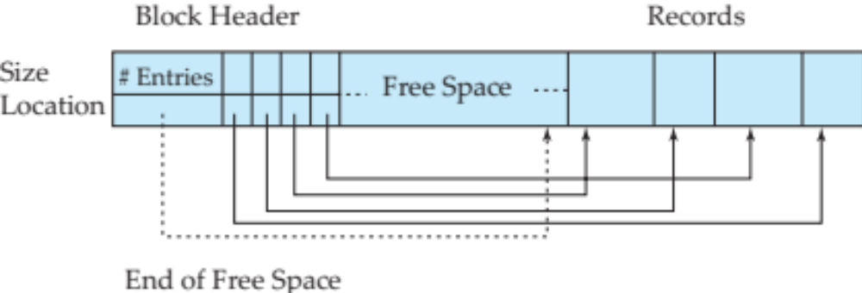
Variable-Length Records: Slotted Page Structure
Slotted page header contains:
  number of record entries
  end of free space in the block
  location and size of each record
Records can be moved around within a page to keep them contiguous with no empty space between them; entry in the header must be updated.
Pointers should not point directly to record — instead they should point to the entry for the record in header.

Slide 9
Storing Large Objects
E.g., blob/clob types
Records must be smaller than pages
Alternatives:
  Store as files in file systems
  Store as files managed by database
  Break into pieces and store in multiple tuples in separate relation
    PostgreSQL TOAST

Slide 10
Organization of Records in Files
Heap – record can be placed anywhere in the file where there is space
Sequential – store records in sequential order, based on the value of the search key of each record
In a multitable clustering file organization records of several different relations can be stored in the same file
  Motivation: store related records on the same block to minimize I/O
B⁺-tree file organization
  Ordered storage even with inserts/deletes
  More on this in Chapter 14
Hashing – a hash function computed on search key; the result specifies in which block of the file the record should be placed
  More on this in Chapter 14

Slide 11
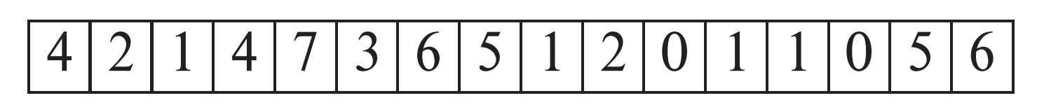
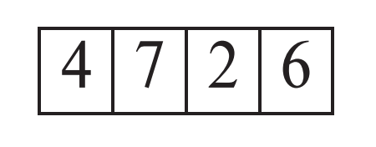
Heap File Organization
Records can be placed anywhere in the file where there is free space
Records usually do not move once allocated
Important to be able to efficiently find free space within file
Free-space map
  Array with 1 entry per block. Each entry is a few bits to a byte, and records fraction of block that is free
  In example below, 3 bits per block, value divided by 8 indicates fraction of block that is free
  Can have second-level free-space map
  In example below, each entry stores maximum from 4 entries of first-level free-space map
Free space map written to disk periodically, OK to have wrong (old) values for some entries (will be detected and fixed)

Slide 12
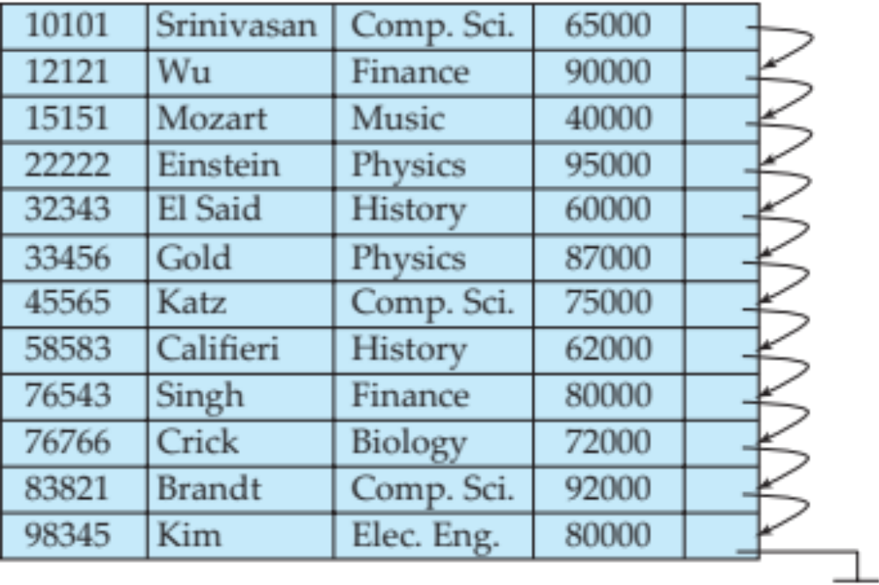
Sequential File Organization
Suitable for applications that require sequential processing of the entire file
The records in the file are ordered by a search-key

Slide 13
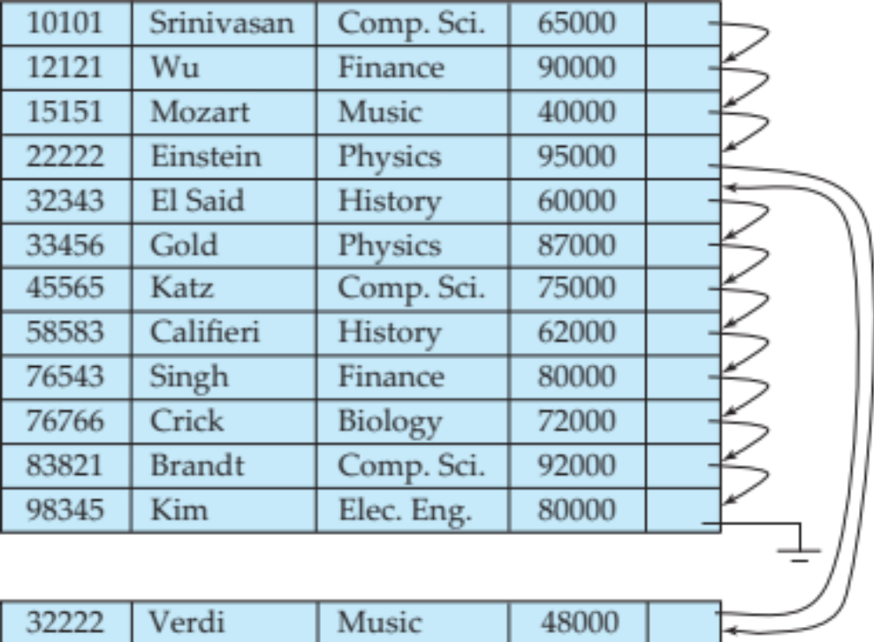
Sequential File Organization (Cont.)
Deletion – use pointer chains
Insertion –locate the position where the record is to be inserted
  if there is free space insert there
  if no free space, insert the record in an overflow block
  In either case, pointer chain must be updated
Need to reorganize the file
from time to time to restore
sequential order

Slide 14
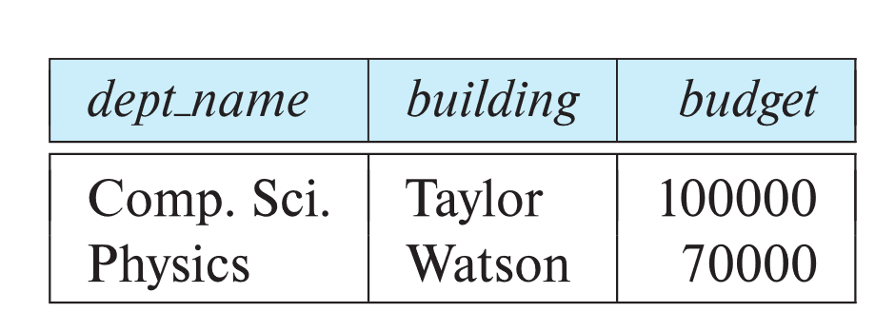
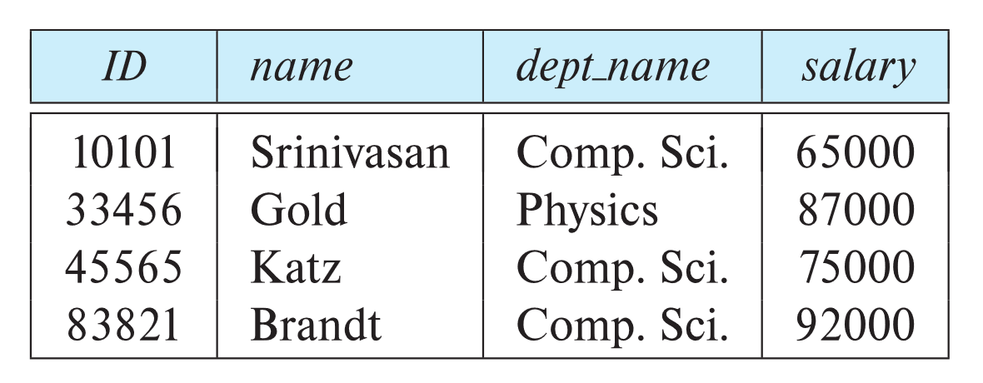
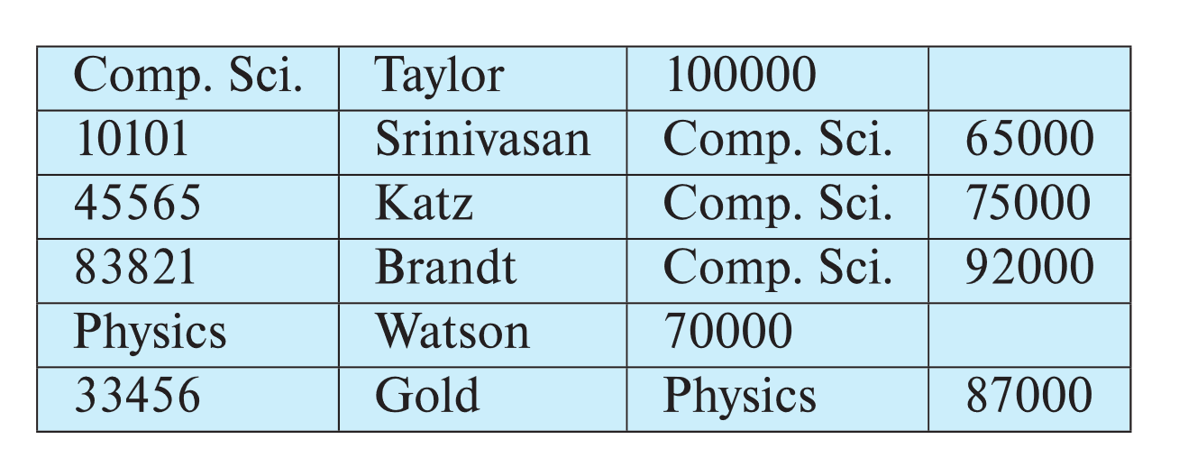
Multitable Clustering File Organization
Store several relations in one file using a multitable clustering file organization
department
instructor
multitable clustering
of department and
instructor

Slide 15
Multitable Clustering File Organization (cont.)
good for queries involving department ⨝ instructor, and for queries involving one single department and its instructors
bad for queries involving only department
results in variable size records
Can add pointer chains to link records of a particular relation

Slide 16
Partitioning
Table partitioning: Records in a relation can be partitioned into smaller relations that are stored separately
E.g., transaction relation may be partitioned into
transaction_2018, transaction_2019, etc.
Queries written on transaction must access records in all partitions
  Unless query has a selection such as year=2019, in which case only one partition in needed
Partitioning
  Reduces costs of some operations such as free space management
  Allows different partitions to be stored on different storage devices
    E.g., transaction partition for current year on SSD, for older years on magnetic disk

Slide 17
Data Dictionary Storage
The Data dictionary (also called system catalog) stores metadata; that is, data about data, such as
Information about relations
  names of relations
  names, types and lengths of attributes of each relation
  names and definitions of views
  integrity constraints
User and accounting information, including passwords
Statistical and descriptive data
  number of tuples in each relation
Physical file organization information
  How relation is stored (sequential/hash/…)
  Physical location of relation
Information about indices (Chapter 14)

Slide 18
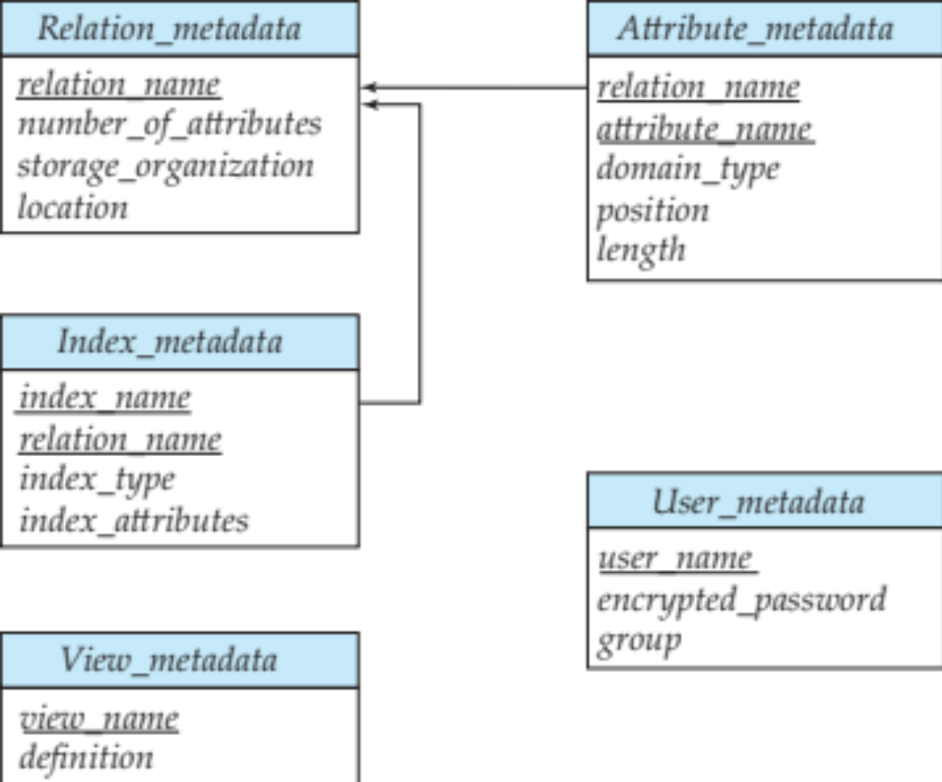
Relational Representation of System Metadata
Relational representation on disk
Specialized data structures designed for efficient access, in memory

Slide 19
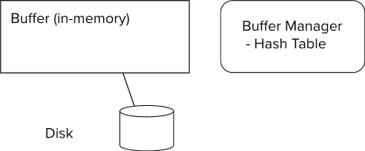
Storage Access
Blocks are units of both storage allocation and data transfer.
Database system seeks to minimize the number of block transfers between the disk and memory. We can reduce the number of disk accesses by keeping as many blocks as possible in main memory.
Buffer – portion of main memory available to store copies of disk blocks.
Buffer manager – subsystem responsible for allocating buffer space in main memory.
Notes:
19

Slide 20
Buffer Manager
Programs call on the buffer manager when they need a block from disk.
  If the block is already in the buffer, buffer manager returns the address of the block in main memory
  If the block is not in the buffer, the buffer manager
    Allocates space in the buffer for the block
      Replacing (throwing out) some other block, if required, to make space for the new block.
      Replaced block written back to disk only if it was modified since the most recent time that it was written to/fetched from the disk.
    Reads the block from the disk to the buffer, and returns the address of the block in main memory to requester.
Notes:
20

Slide 21
Buffer Manager
Buffer replacement strategy (details coming up!)
Pinned block: memory block that is not allowed to be written back to disk
  Pin done before reading/writing data from a block
  Unpin done when read /write is complete
  Multiple concurrent pin/unpin operations possible
    Keep a pin count, buffer block can be evicted only if pin count = 0
Shared and exclusive locks on buffer
  Needed to prevent concurrent operations from reading page contents as they are moved/reorganized, and to ensure only one move/reorganize at a time
  Readers get shared lock, updates to a block require exclusive lock
  Locking rules:
    Only one process can get exclusive lock at a time
    Shared lock cannot be concurrently with exclusive lock
    Multiple processes may be given shared lock concurrently

Slide 22
Buffer-Replacement Policies
Most operating systems replace the block least recently used (LRU strategy)
  Idea behind LRU – use past pattern of block references as a predictor of future references
  LRU can be bad for some queries
Queries have well-defined access patterns (such as sequential scans), and a database system can use the information in a user’s query to predict future references
Mixed strategy with hints on replacement strategy provided
by the query optimizer is preferable
  Example of bad access pattern for LRU: when computing the join of 2 relations r and s by a nested loops
  for each tuple tr of r do
  for each tuple ts of s do
  if the tuples tr and ts match …
Notes:
22

Slide 23
Buffer-Replacement Policies (Cont.)
Toss-immediate strategy – frees the space occupied by a block as soon as the final tuple of that block has been processed
Most recently used (MRU) strategy – system must pin the block currently being processed. After the final tuple of that block has been processed, the block is unpinned, and it becomes the most recently used block.
Buffer manager can use statistical information regarding the probability that a request will reference a particular relation
  E.g., the data dictionary is frequently accessed. Heuristic: keep data-dictionary blocks in main memory buffer
Operating system or buffer manager may reorder writes
  Can lead to corruption of data structures on disk
    E.g., linked list of blocks with missing block on disk
    File systems perform consistency check to detect such situations
  Careful ordering of writes can avoid many such problems
Notes:
23

Slide 24
Optimization of Disk Block Access (Cont.)
Buffer managers support forced output of blocks for the purpose of recovery (more in Chapter 19)
Nonvolatile write buffers speed up disk writes by writing blocks to a non-volatile RAM or flash buffer immediately
  Writes can be reordered to minimize disk arm movement
Log disk – a disk devoted to writing a sequential log of block updates
  Used exactly like nonvolatile RAM
    Write to log disk is very fast since no seeks are required
Journaling file systems write data in-order to NV-RAM or log disk
  Reordering without journaling: risk of corruption of file system data

Slide 25
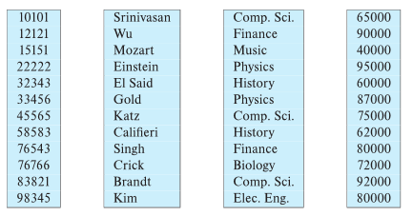
Column-Oriented Storage
Also known as columnar representation
Store each attribute of a relation separately
Example

Slide 26
Columnar Representation
Benefits:
  Reduced IO if only some attributes are accessed
  Improved CPU cache performance
  Improved compression
  Vector processing on modern CPU architectures
Drawbacks
  Cost of tuple reconstruction from columnar representation
  Cost of tuple deletion and update
  Cost of decompression
Columnar representation found to be more efficient for decision support than row-oriented representation
Traditional row-oriented representation preferable for transaction processing
Some databases support both representations
  Called hybrid row/column stores

Slide 27
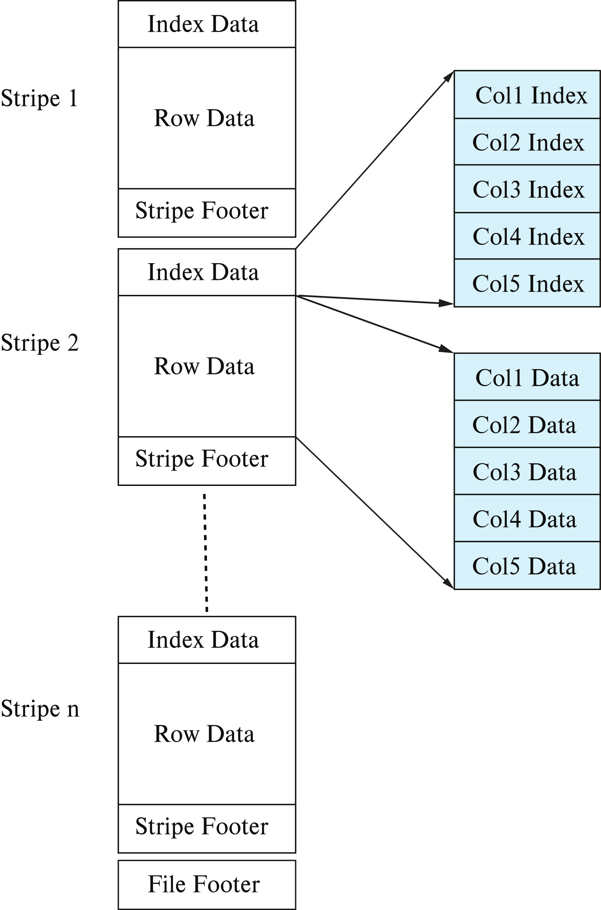
Columnar File Representation
ORC and Parquet: file formats with columnar storage inside file
Very popular for big-data applications
Orc file format shown on right:

Slide 28
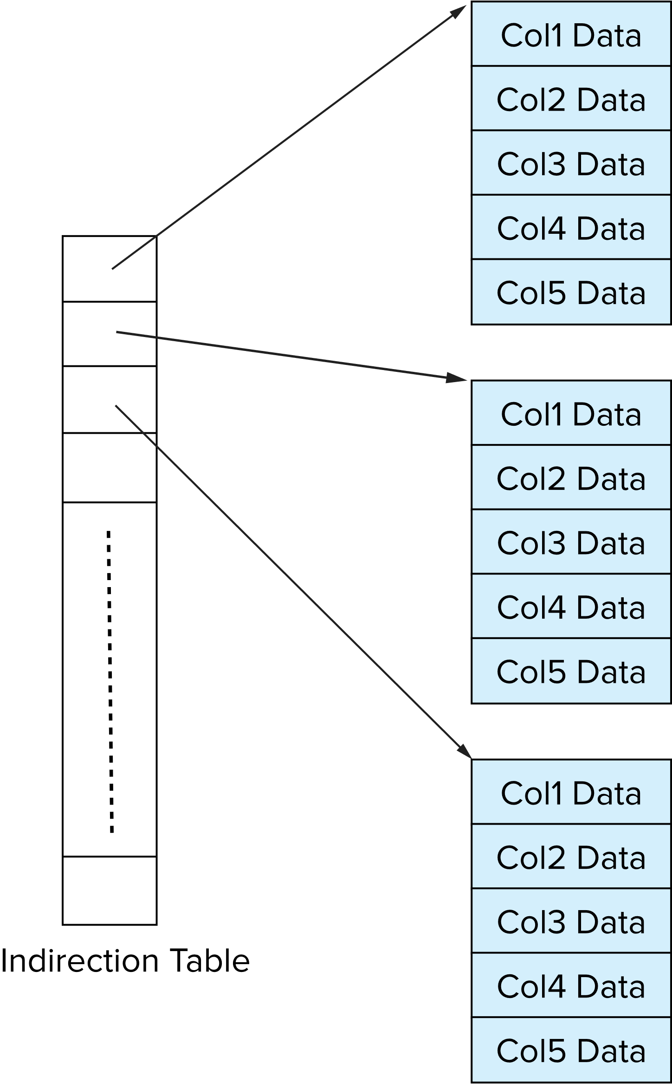
Storage Organization in Main-Memory Databases
Can store records directly in memory without a buffer manager
Column-oriented storage can be used in-memory for decision support applications
  Compression reduces memory requirement

Slide 29
End of Chapter 13

